Slide 1
Social Media Analytics
Topic 11: The Social Media ROI

Slide 2
Learning Objectives
What is Social Media ROI?
How to calculate Social Media ROI?
Social Media KPIs
How to calculate Social Media KPIs?
Measure Social Media ROI using Facebook
Measure Social Media ROI using Twitter

Slide 3
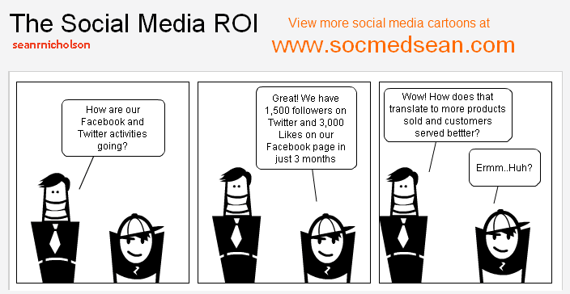

Slide 4
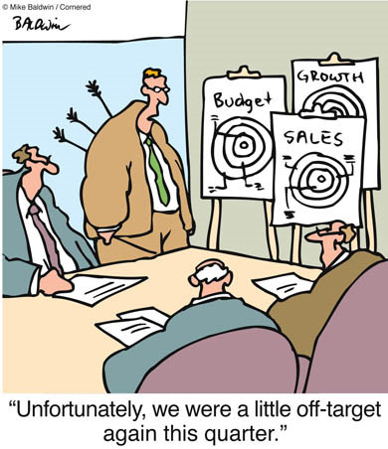
What is Social Media ROI?
It is the details of measuring Return on Investment
ROI can be applied to any business processes that are driven by a social media mythology and not limited to a set of consumer websites
Example: Electrolux use social media tools to capture ideas for business improvement from staff

Slide 5
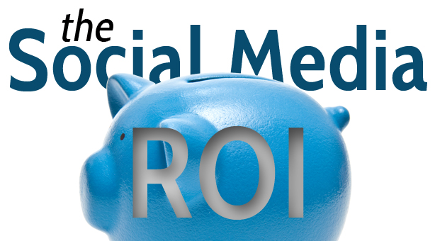
The R and I
What is R for your business looks like
Acquire customers more cheaply?
Reduce costs linked to operation?
Explore a new route to market?
Improve the way your service your customers?

Slide 6
The R and I
Depending on what your R is, you can choose the most relevant I
What sort of people resource you need to put in place to support this?
How much money?
What’s the time frame ?

Slide 7
How to calculate Social media ROI?
Once you have established your R and I, you can concentrate on the execution
ROI =
(Money gained from activity – Cost of activity) -------------------------------------------------------------- Cost of activity

Slide 8
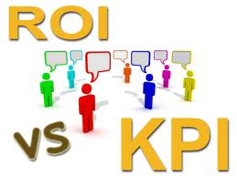
Social media KPIs
In addition to ROI, you can also use Key Performance Indicators (KPIs) to monitor specific areas of your overall social media activity
Different KPIs should be used for different nature of business

Slide 9
How to calculate Social Media KPIs - Advocacy KPIs
Active Audience = Active advocates (last 30 days) ---------------------------------------- Total advocates
Audience Engagement = Unique advocacy influencers ------------------------------------- Total advocacy influence
Conversation Reach = Number of advocacy driven conversation -------------------------------------- Total volume advocacy traffic

Slide 10
How to calculate Social Media KPIs - Dialog KPIs
Share of voice = Brand Mentions --------------------------------------------------- Total Mentioned (Brand + Competitors)
Audience Engagement = Comments + Shares + Trackbacks ---------------------------------------------------- Total Views
Conversation Reach = Total people participates -------------------------------------- Total audience

Slide 11
How to calculate Social Media KPIs - Support KPIs
Issue Resolution Rate = Total issues resolved satisfactorily --------------------------------------------------- Total service issues
Resolution Time = Total inquire response time ---------------------------------------------------- Total number service inquiries
Satisfaction Source = Customer feedback input -------------------------------------- All customer feedback

Slide 12
Measure Social Media ROI using Facebook
Measure
Offers in-house service which creates reports to demonstrate your ad performance and demographic of those engaging with your ad
Offers Ad Level Reporting which shows you the followings:
Breakdown of your spend
“Cost per action”
Breadth of your audience
Depth of engagement with your ad
Summary of targeting and performance

Slide 13
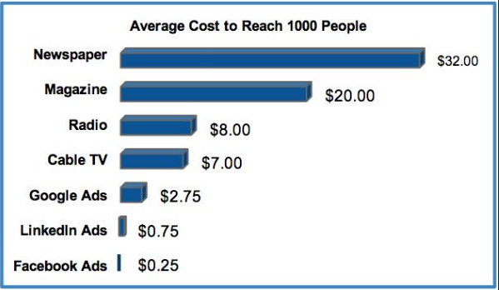
Measure Social Media ROI using Facebook
Cost
Budgeting for Facebook ad is interconnected with reach
Adverts are paid on the basis of impressions, or CPM, or click-through, CPC
Facebook work within your budget as the ads will stop if your run out of credit
Golden State Marketing:
How to increase your website traffic

Slide 14
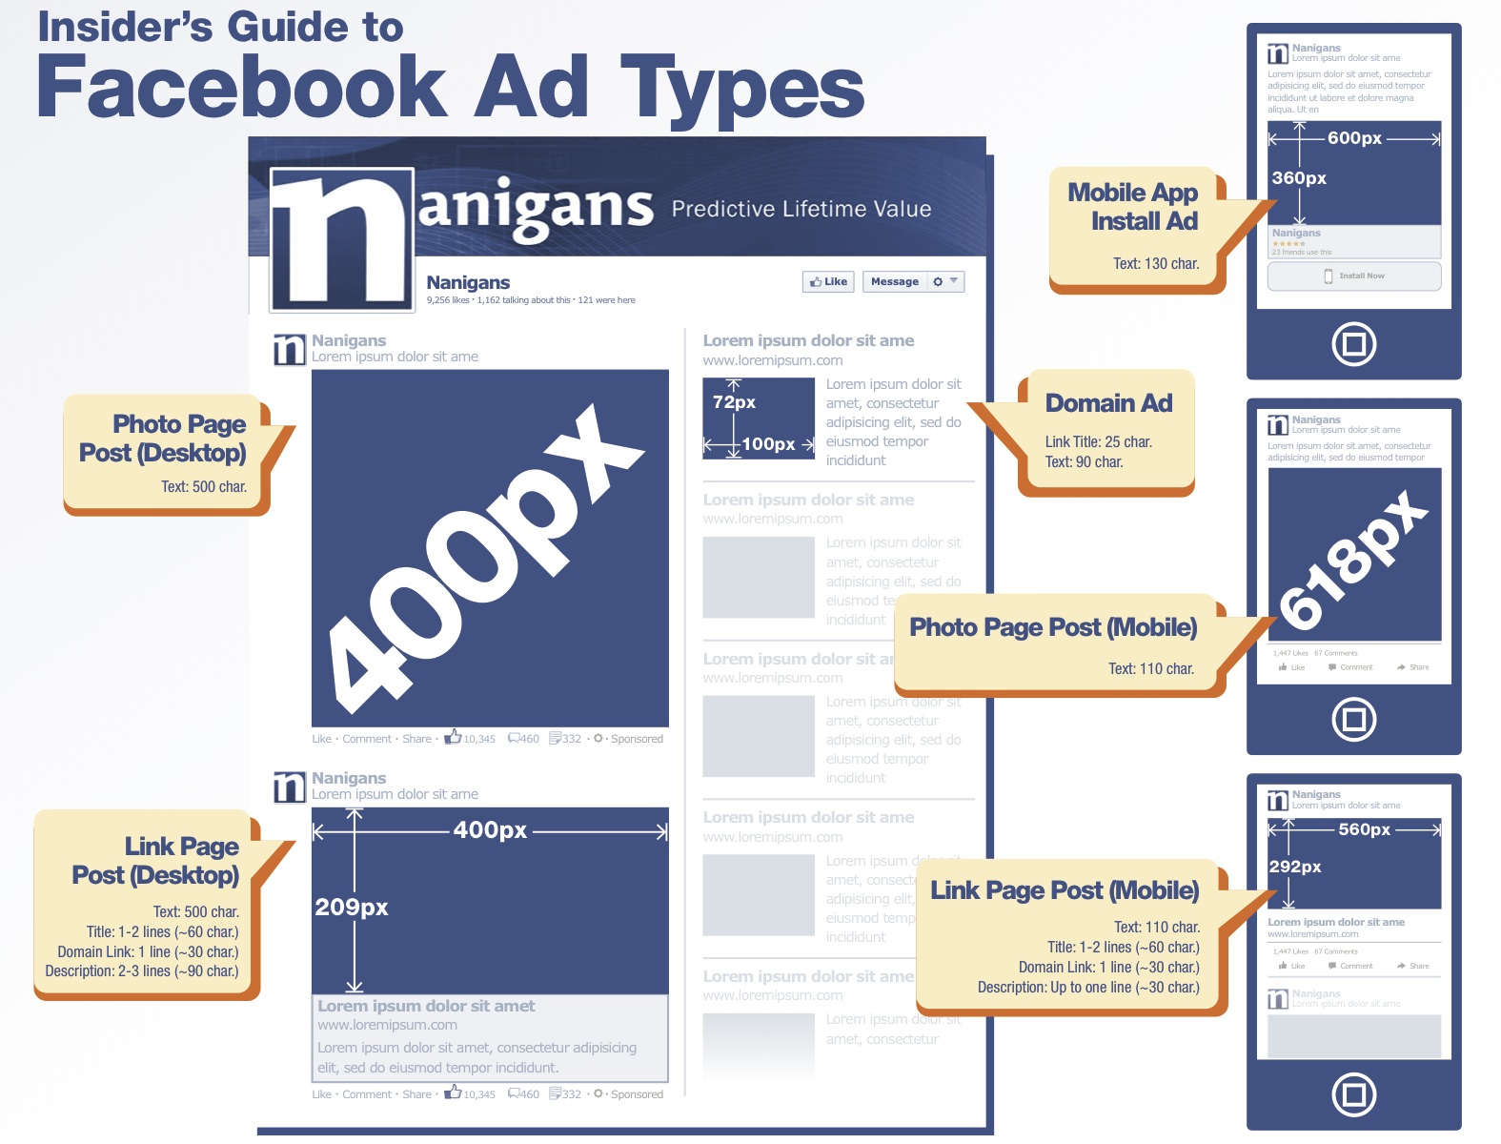
Measure Social Media ROI using Facebook
Adweek.com : Insider’s guide to Facebook ad types

Slide 15
Measure Social Media ROI using Facebook – Case study
How Bulmers (cider brand) of Heineken calculate the value of a Facebook fan?
Develop online panel survey about a range of cider products, including Bulmers on 241 Facebook fans and a control sample of 198 general cider drinkers

Slide 16
Measure Social Media ROI using Facebook – Case study
RESULT !!!
Purchase behaviour
Facebook fans consumed more of Bulmers cider than non-fans
Facebook fans spend 200 pounds a year, around 38% more than the control sample
Reach
75% of fans likely to share good brand experience

Slide 17
Measure Social Media ROI using Facebook – Case study
Reach
75% of fans likely to share good brand experience, promotions and discounts with their Facebook friends
Conclusion and outcome
Facebook fans have a tangible value to the brand
Understanding the monetary value of Facebook fans resulted in the successful #BEGINWITHABULMERS campaign, becoming the most talked about cider brand on social media over summer 2013.

Slide 18
Measure Social Media ROI using Twitter
Twitter - Measure
Express success through popularity and numbers
Influential Twitter users are measured by their number of followers and tweets are “hashtagged” (#) by the users according to their content
“Trending” hashtags look at the most mentioned hashtags across the globe and success is measured based on who or what is trending, how often they trend.

Slide 19
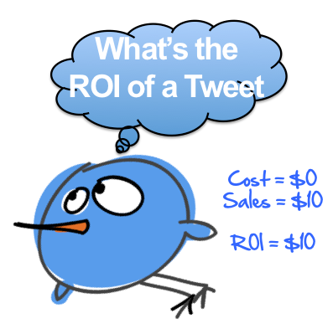
Measure Social Media ROI using Twitter
Measure
Express success through popularity and numbers
Influential Twitter users are measured by their number of followers and tweets are “hashtagged” (#) by the users according to their content
“Trending” hashtags look at the most mentioned hashtags across the globe and success is measured based on who or what is trending, how often they trend.

Slide 20
Measure Social Media ROI using Twitter
Measure
Two plan of action
Analyse the content of your tweets and interaction with your followers to access impact. This is qualitative approach
Partner with one of Twitter’s certified business service providers who will help deliver your metrics

Slide 21
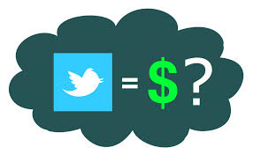
Measure Social Media ROI using Twitter
Cost
Twitter activity is free
Paid services:
Boost your profile through promoting your account, connect to same interest group and listing in “Who to follow”
Only pay when users choose to follow you
Real time service to show your influence
Measure your followers in relation to your brand
Broken down in geographical or gender basis

